Slide 1

Mikrotik TTT
Selective Failover & Intentional Service Segmentation
Using MikroTik RouterOS v7
Date: 11/27/2025
Instructor: Aaron Gustafson
Website: ByteMeNetworks.com
Course Level: MTCRE – MikroTik Certified Routing Engineer Session Length: 1 Hour (Lecture + Lab)
This Module Tested on rOS 7.20.4

Slide 2
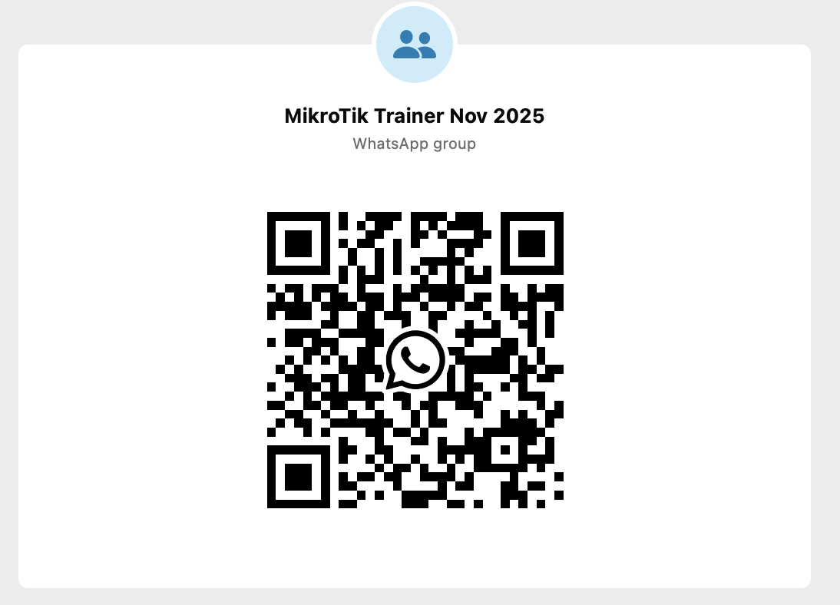
Intro (And instruction following exercise)

Slide 3
What we will cover
Real-world need for selective multi-WAN failover
RouterOS v7 policy routing concepts (Mangle Vs Routing Rules)
Building routing tables and routing rules
Creating business-critical vs. non-critical VLAN paths
Implementing selective failover logic
Hands-on lab: full configuration + failover test

Slide 4
IP Routing
From MikroTik Wiki and the MTCNA course – a brief review
Routing is the process of selecting paths across the networks to move packets from one host to another.
Remember that the most specific route is used /32 will be used before a /24

Slide 5
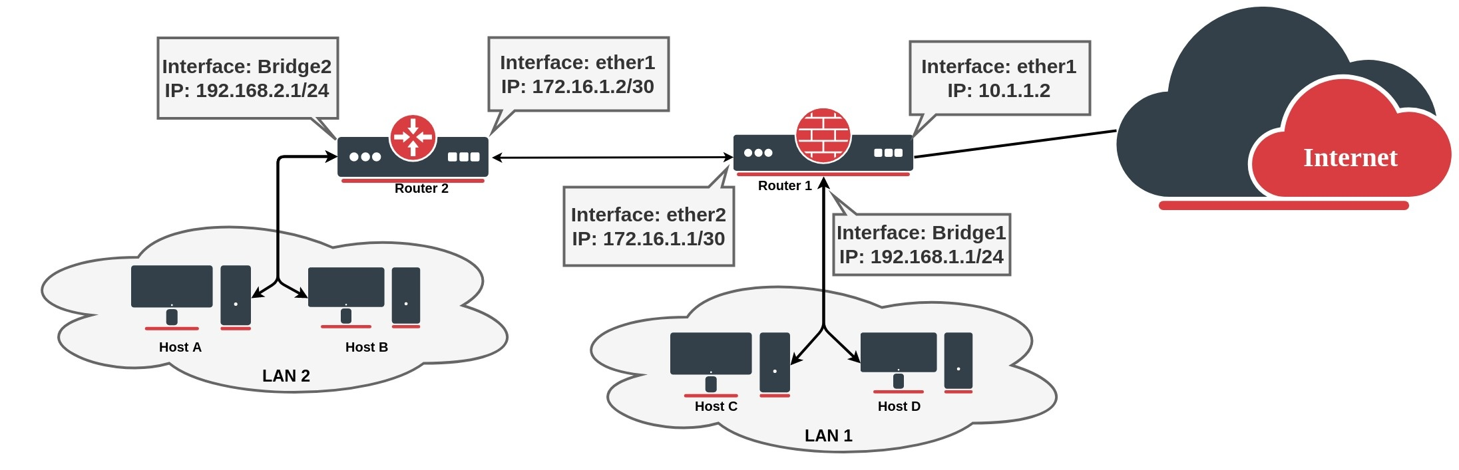
IP Routing
Notes:
If we look, for example, at the Router1 routing table, we can see that the router knows only about directly connected networks. At this point, when the Client from LAN1 tries to reach the client from LAN2 (192.168.2.0/24), a packet will be dropped on the router, because the destination is unknown for the particular router
To fix this we need to add a route that tells the router what is the next device in the network to reach the destination. In our example next hop is Router2, so we need to add a route with the gateway that points to the Router's 2 connected address. This type of route is known as a static route
At this point packet from LAN1 will be successfully forwarded to LAN2, but we are not over yet. Router2 does not know how to reach LAN1, so any packet from LAN2 will be dropped on Router2.
If we look again at the network diagram, we can clearly see that Router2 has only one point of exit. It is safe to assume that all other unknown networks should be reached over the link to Router1. The easiest way to do this is by adding a default route: To add a default route set destination 0.0.0.0/0 or leave it blank. As we have seen from the example setup, there are different groups of routes, based on their origin and properties.

Slide 6
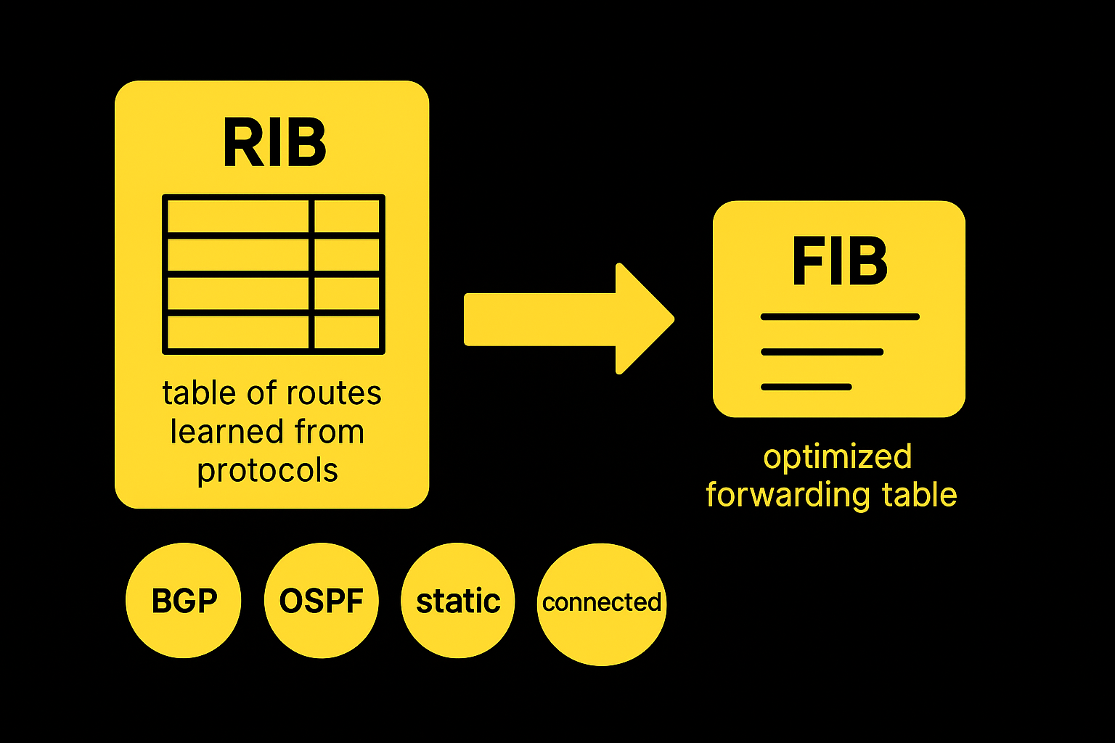
FIB and RIB
RouterOS routing information consists of two main parts:
FIB (Forwarding Information Base), is used to make packet forwarding decisions. It contains a copy of the necessary routing information.
RIB (Routing Information Base) contains all learned prefixes from routing protocols (connected, static, BGP, RIP, OSPF).

Slide 7
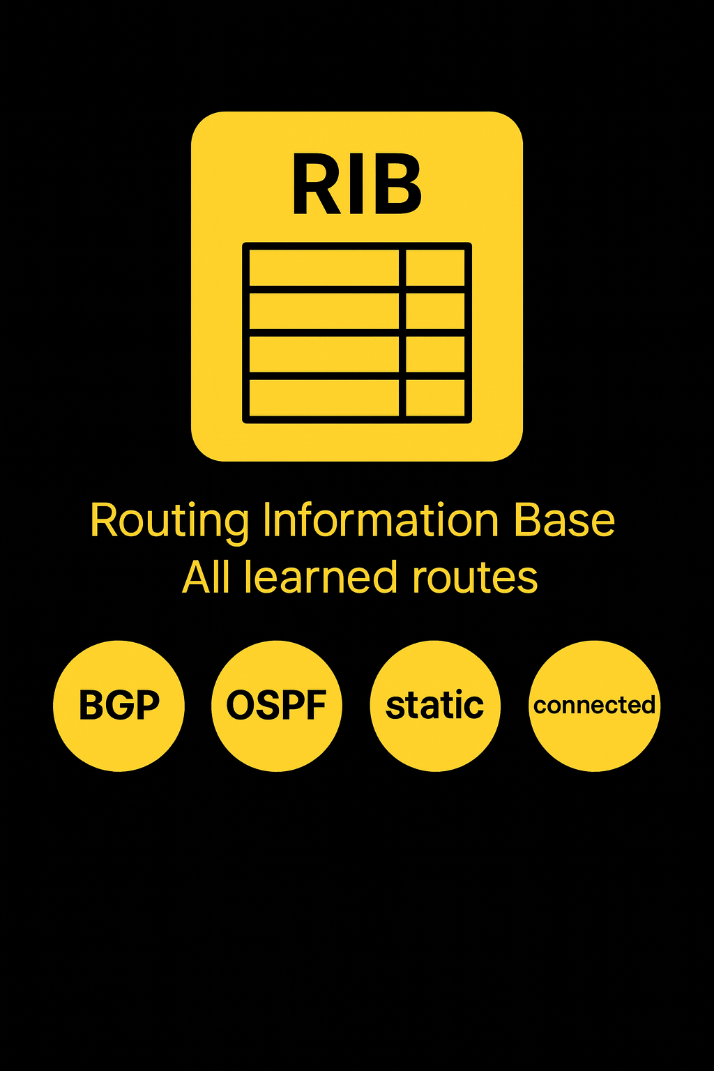
RIB
Routing Information Base is a database that lists entries for particular network destinations and their gateways (address of the next device along the path or simply next-hop). One such entry in the routing table is called a route.
A hop occurs when a packet is passed from one network segment to another.
By default, all routes are organized in one "main" routing table. It is possible to make more than one routing table which we will discuss further in this module.

Slide 8
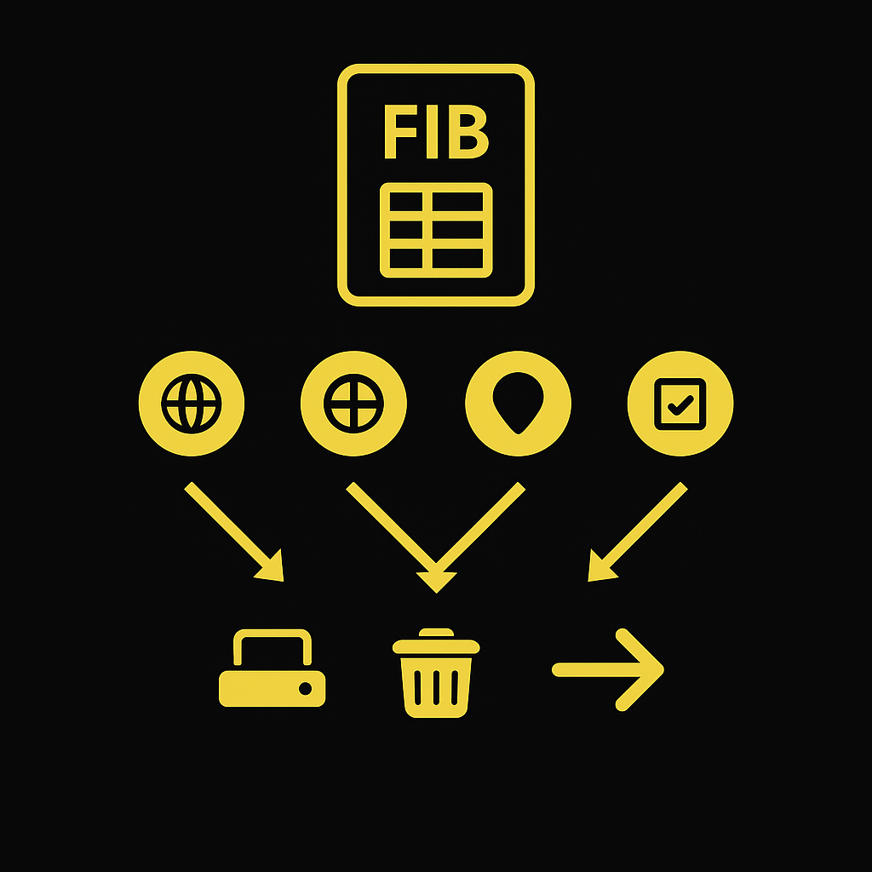
FIB
FIB uses the following information from the packet to determine its destination:
source address
destination address
source interface
routing mark
Possible routing decisions are:
receive packet locally
discard the packet (either silently or by sending an ICMP message to the sender of the packet)
send the packet to a specific IP address on a specific interface

Slide 9
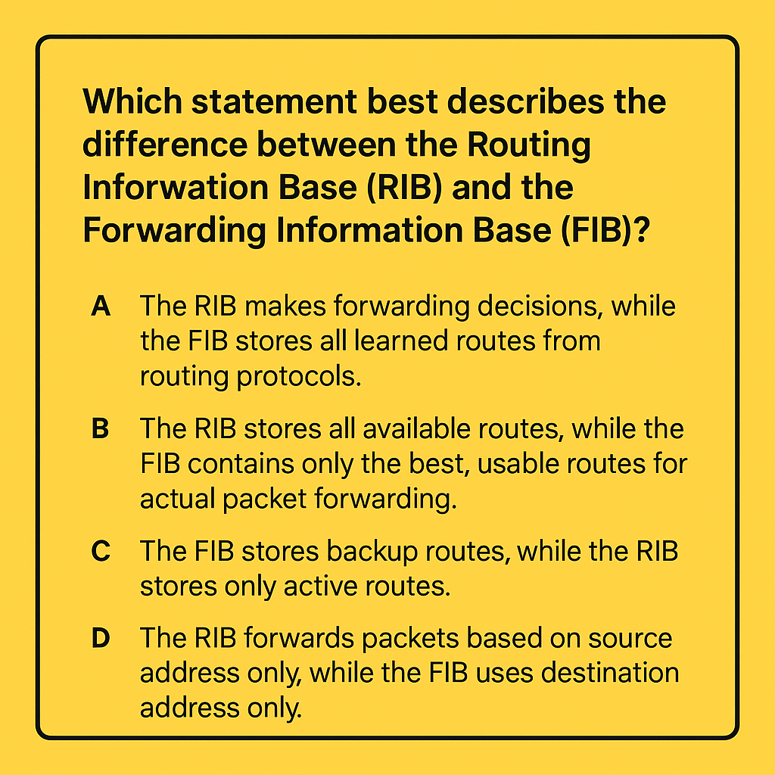

Slide 10
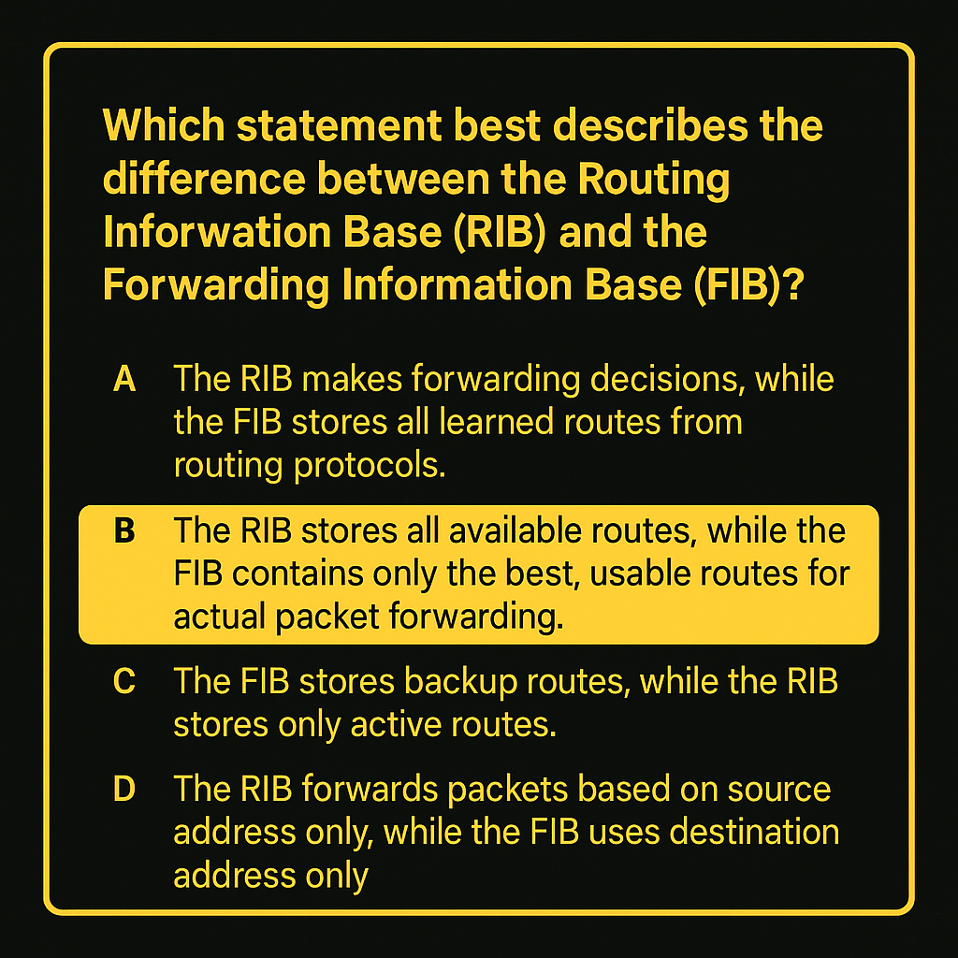

Slide 11
Why Selective Failover Matters
Businesses (At least in the US) often have two WAN connections
ISP1: Primary (Fiber/Coax)
ISP2: Backup (LTE)
Not all traffic should fail over
Business-critical devices must stay online
Guest Wi-Fi / non-essential services can be dropped
Preserves limited LTE bandwidth for priority operations
Used widely in retail and hospitality
Example: Chick-fil-A (Quick Service Restaurant) POS networks fail over; guest Wi-Fi does not to allow Card Processing
Can sometimes save money when dealing with per-usage billing for backup circuits

Slide 12
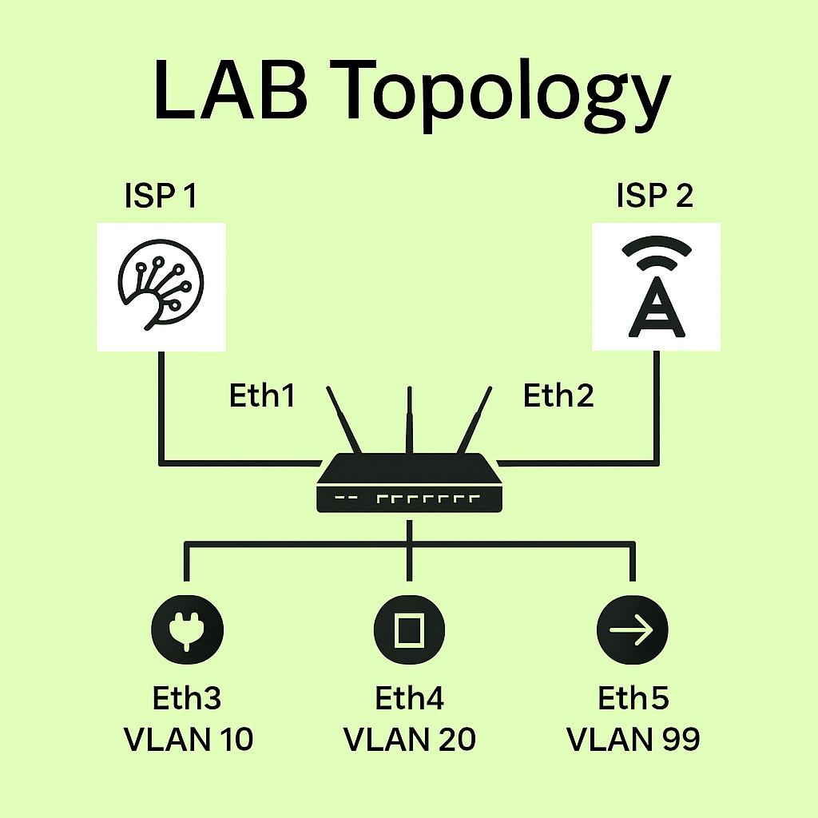
Lab Topology

Slide 13
Policy Goals
Office WiFi (VLAN10) → Use ISP1 → Fail over to ISP2
Office Wired (VLAN20) → Use ISP1 → Fail over to ISP2
Guest WiFi (VLAN99) → Use ISP1 → Do not fail over (Intentionally loses Internet during outage)
to_isp1 | Primary Fiber (ISP1) + Failover to ISP2
guest_isp1 | Guest-only → ISP1 only (no fallback)

Slide 14
Initialization
Go to TTT.ByteMeNetworks.com and open both Base Config and Solutions
Factory Reset your router with no-default config and winbox into your router
Copy and paste the Base Config Text into CLI
Password after config will be admin/admin
TIP: Make a backup using Terminal “export file=backup show-sensitive”

Slide 15
Configuration
1. Create Routing Tables
to_isp1
guest_isp1
/routing table
add name=to_isp1 fib
add name=guest_isp1 fib
TIP: When working on a remote MikroTik using Winbox, always use Safe Mode. Turn Safe Mode on, make your changes, and then turn it off and back on again at each checkpoint. This creates a “save point,” so if you lose connection, the router will automatically roll back to the last Safe Mode save instead of locking you out.

Slide 16
Configuration
2. Add Default Routes per Table
ISP1 primary (distance 1)
ISP2 backup (distance 2)
Guest table ONLY includes ISP1
/ip route
add dst-address=0.0.0.0/0 gateway=192.168.1.1 routing-table=to_isp1 distance=1 check-gateway=ping
add dst-address=0.0.0.0/0 gateway=192.168.2.1 routing-table=to_isp1 distance=2 check-gateway=ping
add dst-address=0.0.0.0/0 gateway=192.168.1.1 routing-table=guest_isp1 distance=1 check-gateway=ping

Slide 17
Configuration
3. Add Routing Rules
VLAN10 → to_isp1
VLAN20 → to_isp1
VLAN99 → guest_isp1 (lookup-only-in-table)
/routing rule
add src-address=192.168.10.0/24 action=lookup-only-in-table table=to_isp1
add src-address=192.168.20.0/24 action=lookup-only-in-table table=to_isp1
add src-address=192.168.99.0/24 action=lookup-only-in-table table=guest_isp1

Slide 18
Configuration
4. Test ISP 1 functional
Ping from each VLAN
Simulate ISP1 failure
Observe selective failover behavior
From Ether 3 Ping 172.26.2.1
From Ether 4 Ping 172.26.2.1
From Ether 5 Ping 172.26.2.1

Slide 19
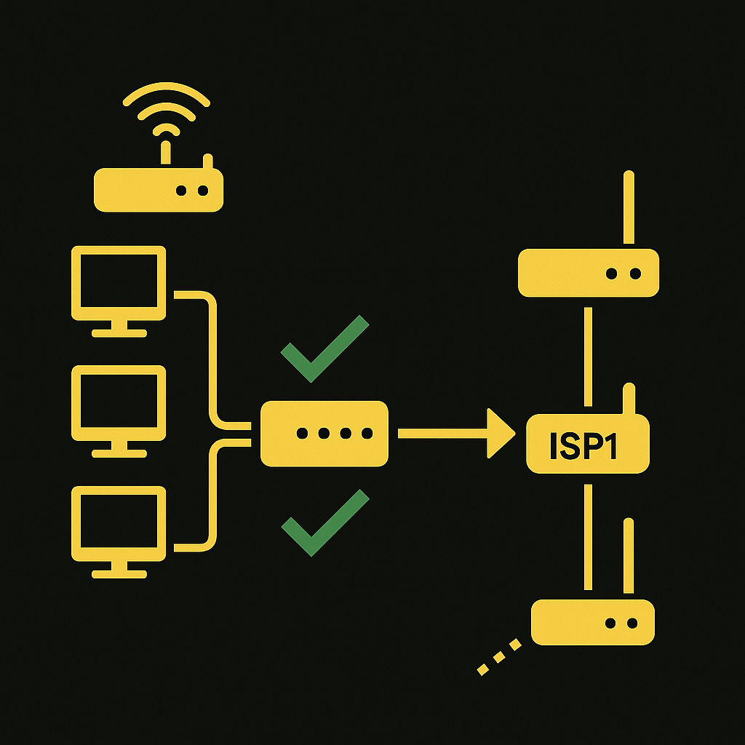
Testing
From all VLANs, test:
ping 172.26.2.1
Expected: ✔ All VLANs reach 172.26.2.1 via ISP1 ✔ Guest VLAN works normally ✔ No traffic uses 192.168.2.1 yet
Optional traceroute (if needed):
traceroute 172.26.2.1.

Slide 20
Configuration
5. Test ISP 1 failure
From Ether 3 Ping 172.26.2.1 – should work
From Ether 4 Ping 172.26.2.1 – should work
From Ether 5 Ping 172.26.2.1 – SHOULD NOT WORK

Slide 21
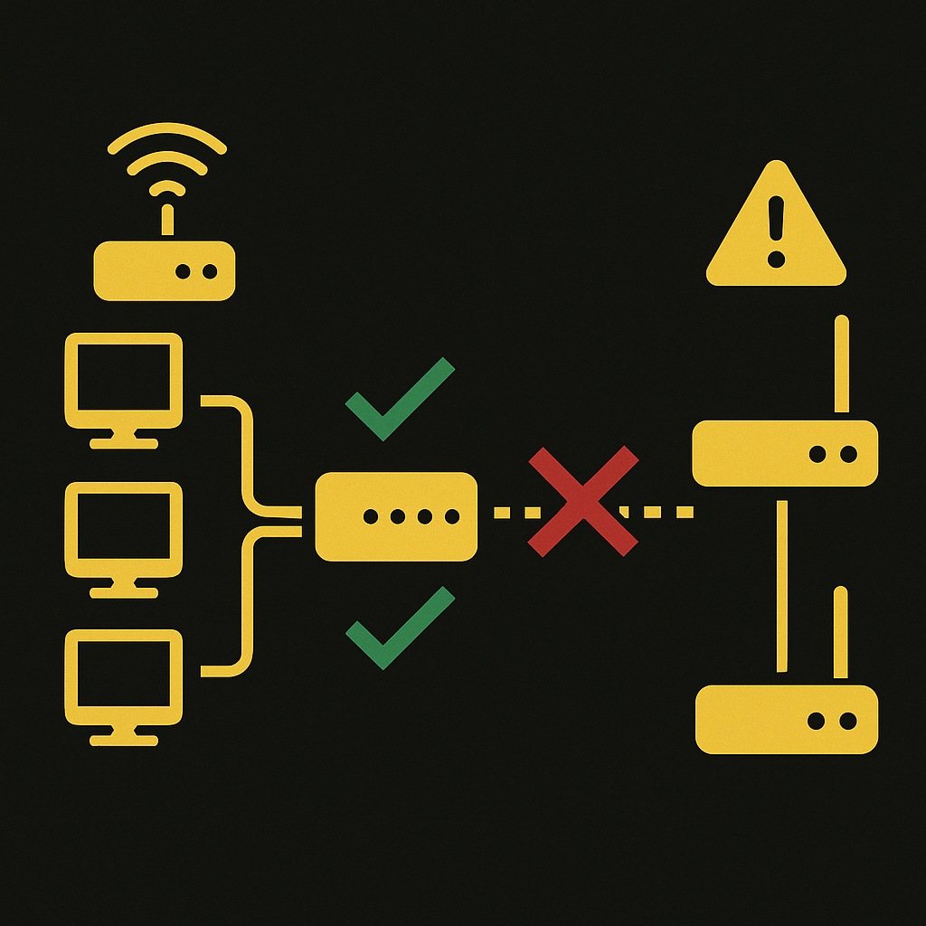
Testing
Simulate ISP1 Failure
Business VLANs (10 & 20):
ping 172.26.2.1
Expected: ✔ Should reach 172.26.2.1 (failover to ISP2)
Guest VLAN (99):
ping 172.26.2.1
Expected: ✘ Should not get a reply ✘ Should not have a route to ISP2

Slide 22
Summary
What You Learned Today
How RouterOS v7 handles Policy-Based Routing (PBR)
Creating and managing multiple routing tables
Assigning VLANs to specific routing tables using routing rules
Using lookup-only-in-table to enforce strict path isolation
Building selective WAN failover between two upstreams
Verifying routing behavior with targeted tests (e.g., ping 172.26.2.1)
Real-World Use Cases
Retail networks: POS continuity and guest WiFi isolation
Branch sites using LTE / satellite as secondary WAN
MSP environments requiring customer or service-tier segmentation
Reducing usage on metered or high-cost backup links

Slide 23
Summary
Closing Notes
This entire configuration works on any MikroTik running RouterOS v7+.
The design scales easily—add more VLANs or WANs without changing the core logic.
You now have a reusable template for real-world selective failover deployments.
Branding Tip
Use CNAMEs to mask the default MikroTik DDNS and present a branded domain: serial.mynetname.com → customer.ByteMeNetworks.com Great for VPNs, camera access, and keeping your company name front-and-center.
Security Tip
The MikroTik default config is only a starting point—it's not secure. Build your own standardized, hardened default configuration to maintain consistent security across every deployment.

Slide 24
Contact Info
Download a copy of this Presentation at TTT.ByteMeNetworks.com
E-mail: Aaron@ByteMeNetworks.com Office Number: +1 254 845 6012
Access Tip:
Use Address Lists and FQDNs for your home or corporate routers so you always have a reliable way to reach remote devices. Example: point home.bytemenetworks.com (CNAME) to your MikroTik DDNS name (serial.mynetname.com) to avoid getting locked out if the IP changes.
On remote Routers:
/Ip firewall address-list add address=home.bytemenetworks.com comment=Home.bytemenetworks.com list="Exempt IP Addresses"
/Ip Firewall Filter add action=accept chain=input comment="Allow Exempt IP Addresses" src-address-list="Exempt IP Addresses"

